Slide 1
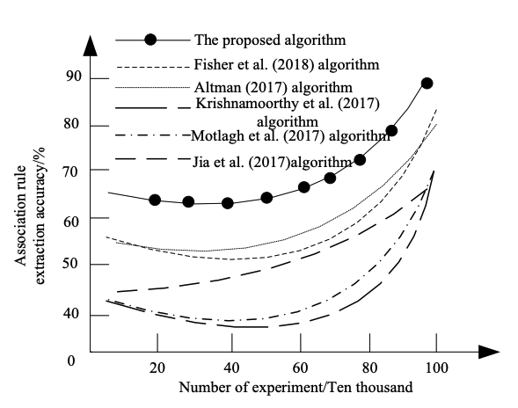
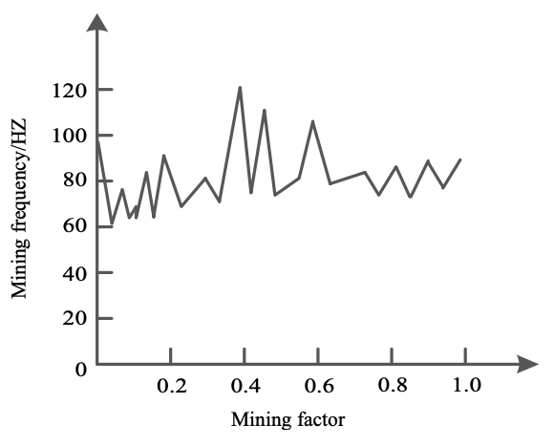
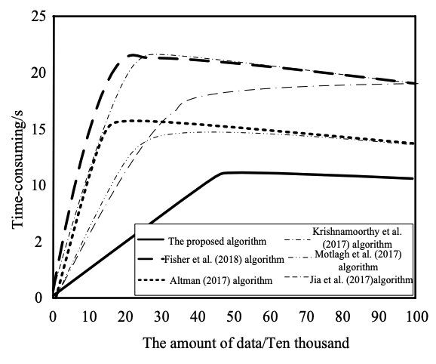
Intelligent Mining of Complex Medical Data
Challenges in Complex Medical Data Analysis
Proposed intelligent mining algorithm
Deep learning approach for complex medical data
Addressing low precision, long processing time, and low recall rate
Discretization and association rule extraction
Experimental validation and results

